Slide 1
Names
Name
Name
Name
…
(Name here all students who worked on the slides)

Slide 2

Get to Know Each Other
Look at the example meme below
Fill out the meme template on slide 3 with pictures you find accurate
Answer the questions on slide 4-6
Share your meme/answers with us via Moodle

Slide 3
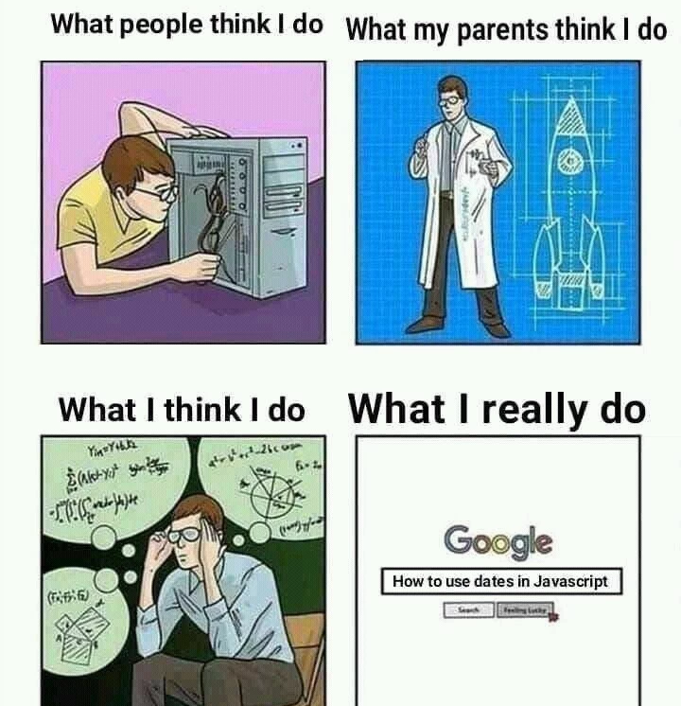
Programmer

Slide 4
Group Activity
Study Program: (please indicate e.g. IBE, RCSE, MCS, CS…)
What other people think I do
What my parents think I do
What I actually do

Slide 5
Study Program: (Please indicate here)
Share your answers to the following question
Students from our study program are good at… and can handle that part of the project (think skills such as coding, API, literature review, data analysis, presentation skills…)

Slide 6
Study Program: (Please indicate here)
Share your answers to the following question
The hardest part of this project for students from our study program will be… (think skills such as coding, API, literature review, data analysis, presentation skills…)

Slide 7
Study Program: (Please indicate here)
Share your answers to the following question
What are some group ground rules that we think can help this group project run smoother?

